Slide 1
Malaria and maritime traffic on the Colombian Pacific coast
Aimee R. Taylor
Diego F. Echevarry
Timothy J. Anderson
Daniel E. Neafsey
Caroline O. Buckee
Notes:
Add research question
Summary
Travel time correlation
Something about travel frequency

Slide 2
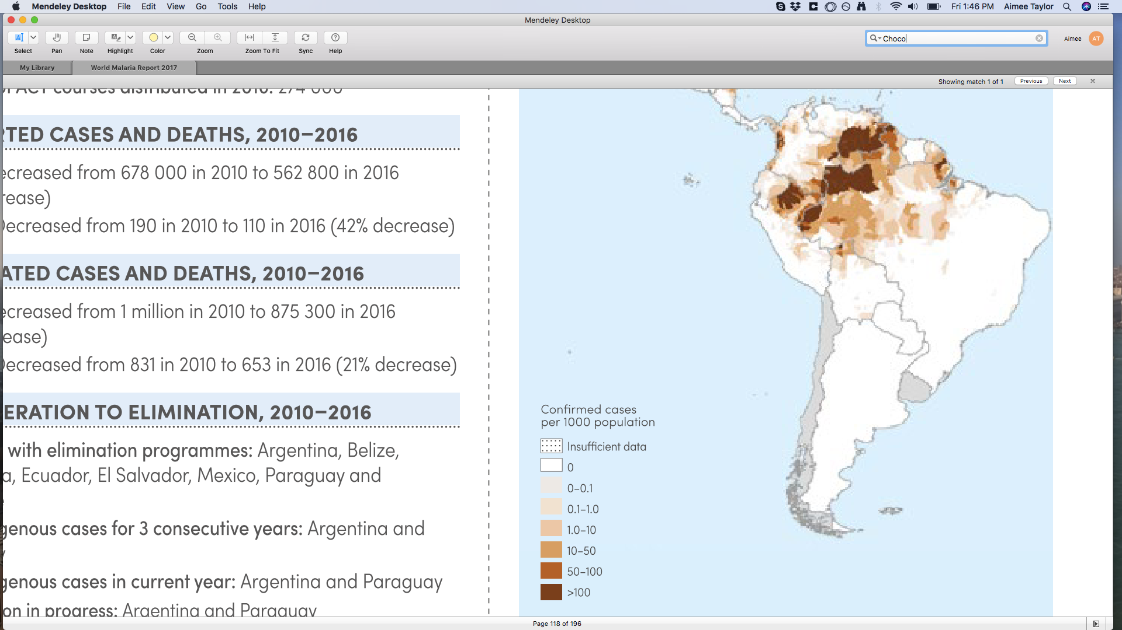
Evidence of connectivity between malaria parasite populations on the Colombian Pacific coast?
WHO World Malaria Report (2017)
Malaria incidence almost halved between 2010-2016
However, cases doubled between 2015 and 2016
More P. falciparum than P. vivax in 2016
Hotspot of transmission: Choco
Notes:
Malaria incidence almost halved between 2010-2016
However, cases doubled between 2015 and 2016
More P. falciparum than P. vivax in 2016
Hotspot of transmission: Choco
P. Facliparum < P. Vivax in 2010
P. Facliparum > P. Vivax in 2016
Begs the question: impact of human mobility?

Slide 3
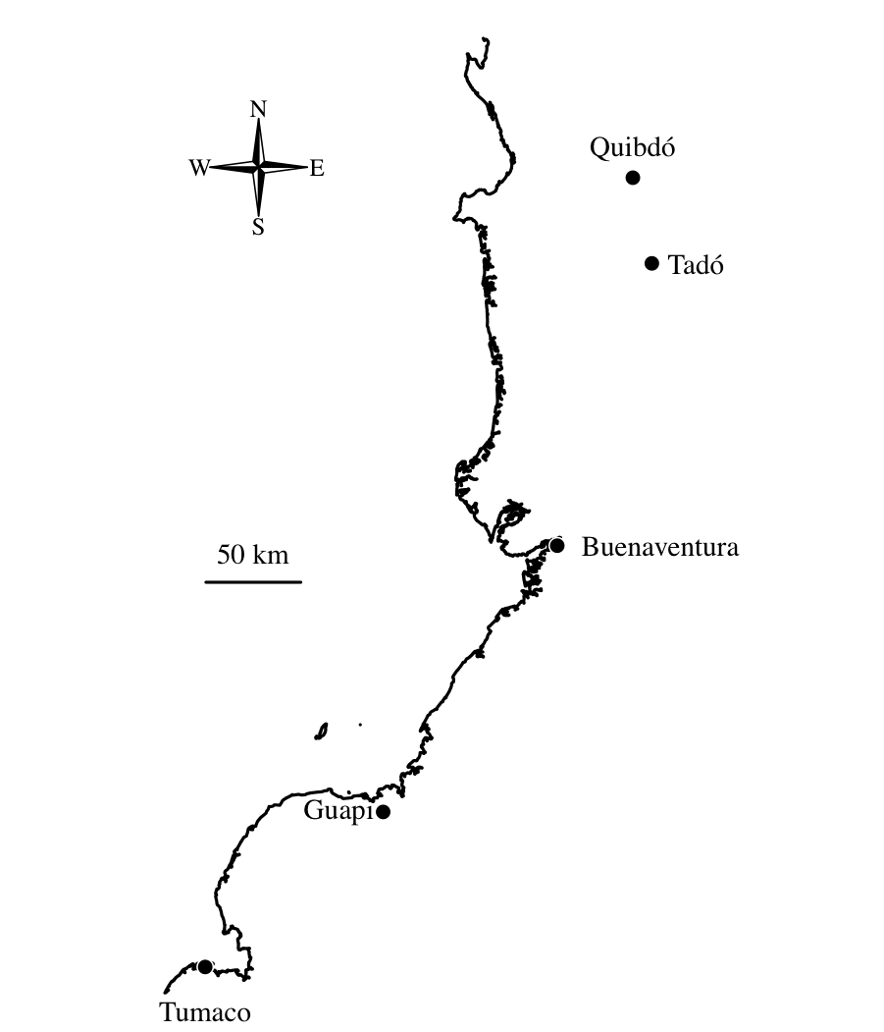
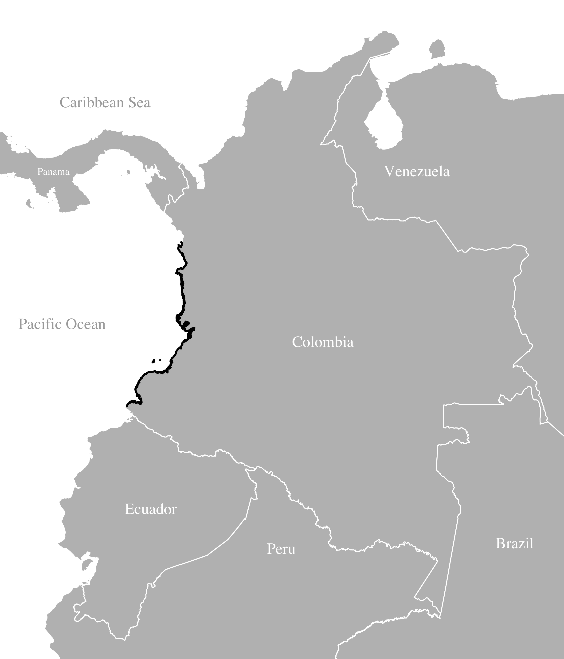
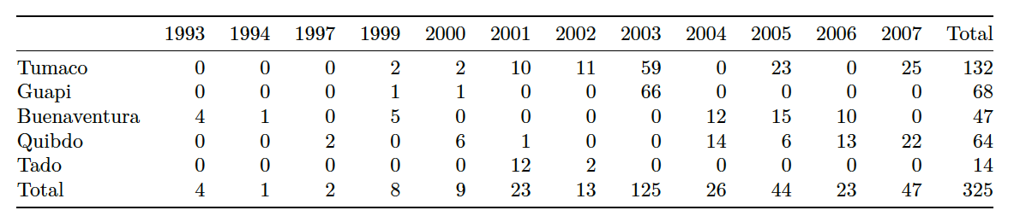
Previously published P. falciparum data from the Colombian Pacific Coast
325 single-genotype parasite samples collected between 1993 and 2007 and genotyped at 250 single nucleotide polymorphisms (SNPs)
Echeverry,D.F. et al. (2013) BMC Genet.
Notes:
Collected to better understand the population structure of Colombian Plasmodium falciparum in preparation for genotype-phentotype studies of Colombian samples
Long term persistence of clonal malaria parasite Plasmodium falciparum lineages in the ColombianPacific region
Cases per 1000 inhabitants highest in Choco (10-20 cases per year) and Nariño (approx. 10) other < 5
"Colombia has approximately 100,000 malaria cases per year and >60%" of the population is at risk. Unstable transmission, all ages, mostly symptomatic.
Previous studies in Colombia have shown low genetic diversity, "low levels of multiclonal infections. 90% of population in the data-collaction region are Afro-Colombians.
A set of 384 SNPs were genotyped in blood spot DNA samples from 447 P. falciparum infected subjects collected over a ten year period from four provinces of the Colombian Pacific coast to evaluate clonality, population structure and linkage disequilibrium (LD). Most infections (81%) contained a single predominant clone. These clustered into 136 multilocus genotypes (MLGs), with 32% of MLGs recovered from multiple (2 – 28) independent subjects. We observed extremely low genotypic richness (R = 0.42) and long persistence of MLGs through time (median = 537 days, range = 1 – 2,997 days). There was a high probability (>5%) of sampling parasites from the same MLG in different subjects within 28 days, suggesting caution is needed when using genotyping methods to assess treatment success in clinical drug trials. Panmixia was rejected as four well differentiated subpopulations (FST = 0.084 - 0.279) were identified. These occurred sympatrically but varied in frequency within the four provinces. Linkage disequilibrium (LD) decayed more rapidly (r2 = 0.17 for markers <10 kb apart) than observed previously in South American samples.

Slide 4
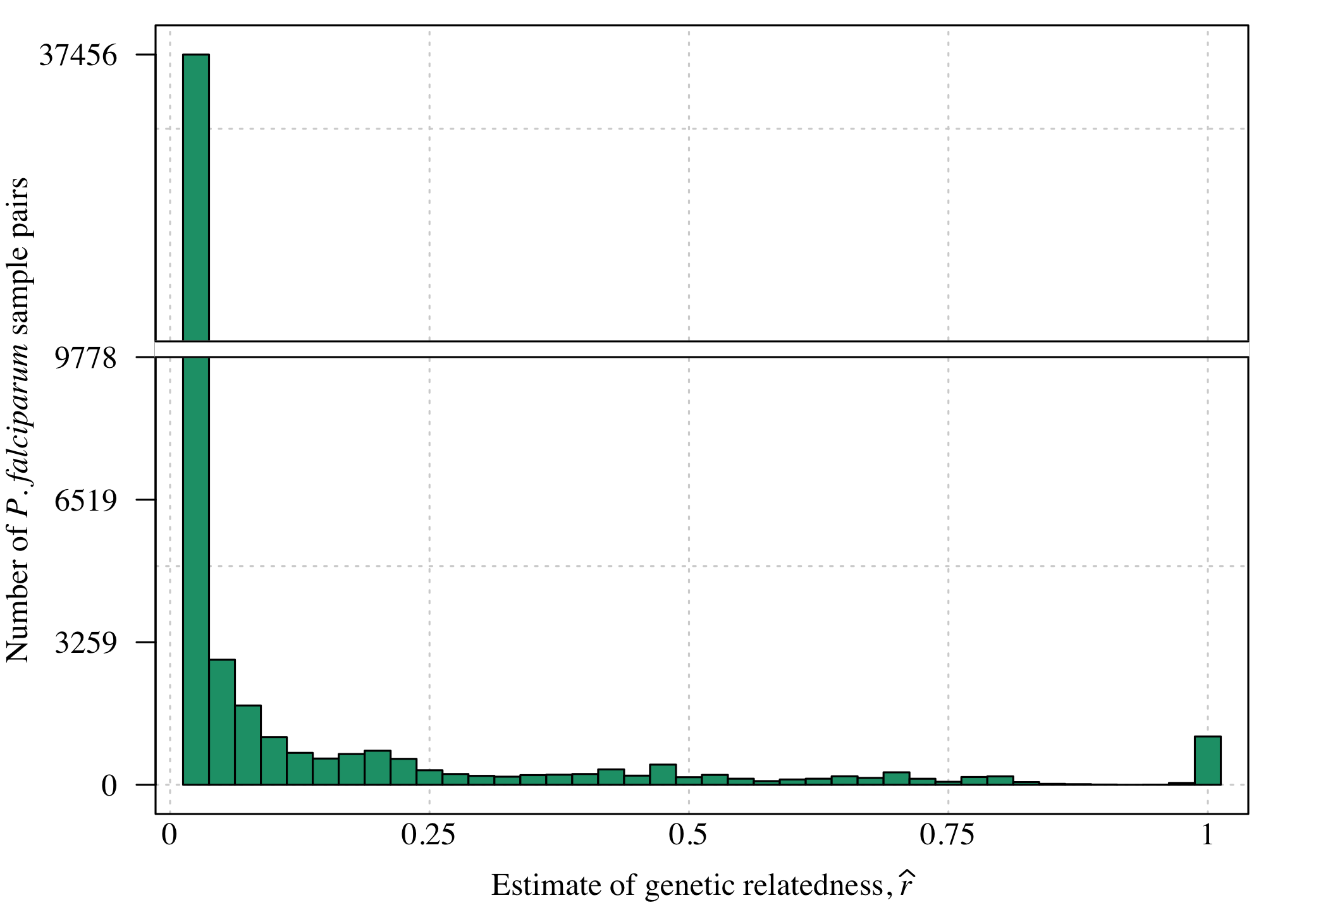
Estimates of genetic relatedness for all pairwise comparisons of samples
﻿Estimates generated using hmmIBD Schaffner, et al. (2018)

Slide 5
P. falciparum sample pairs more highly related if collected within the same site versus across different sites
Group estimates by sites
Plot proportion > 0.5 by sites
Unpublished

Slide 6
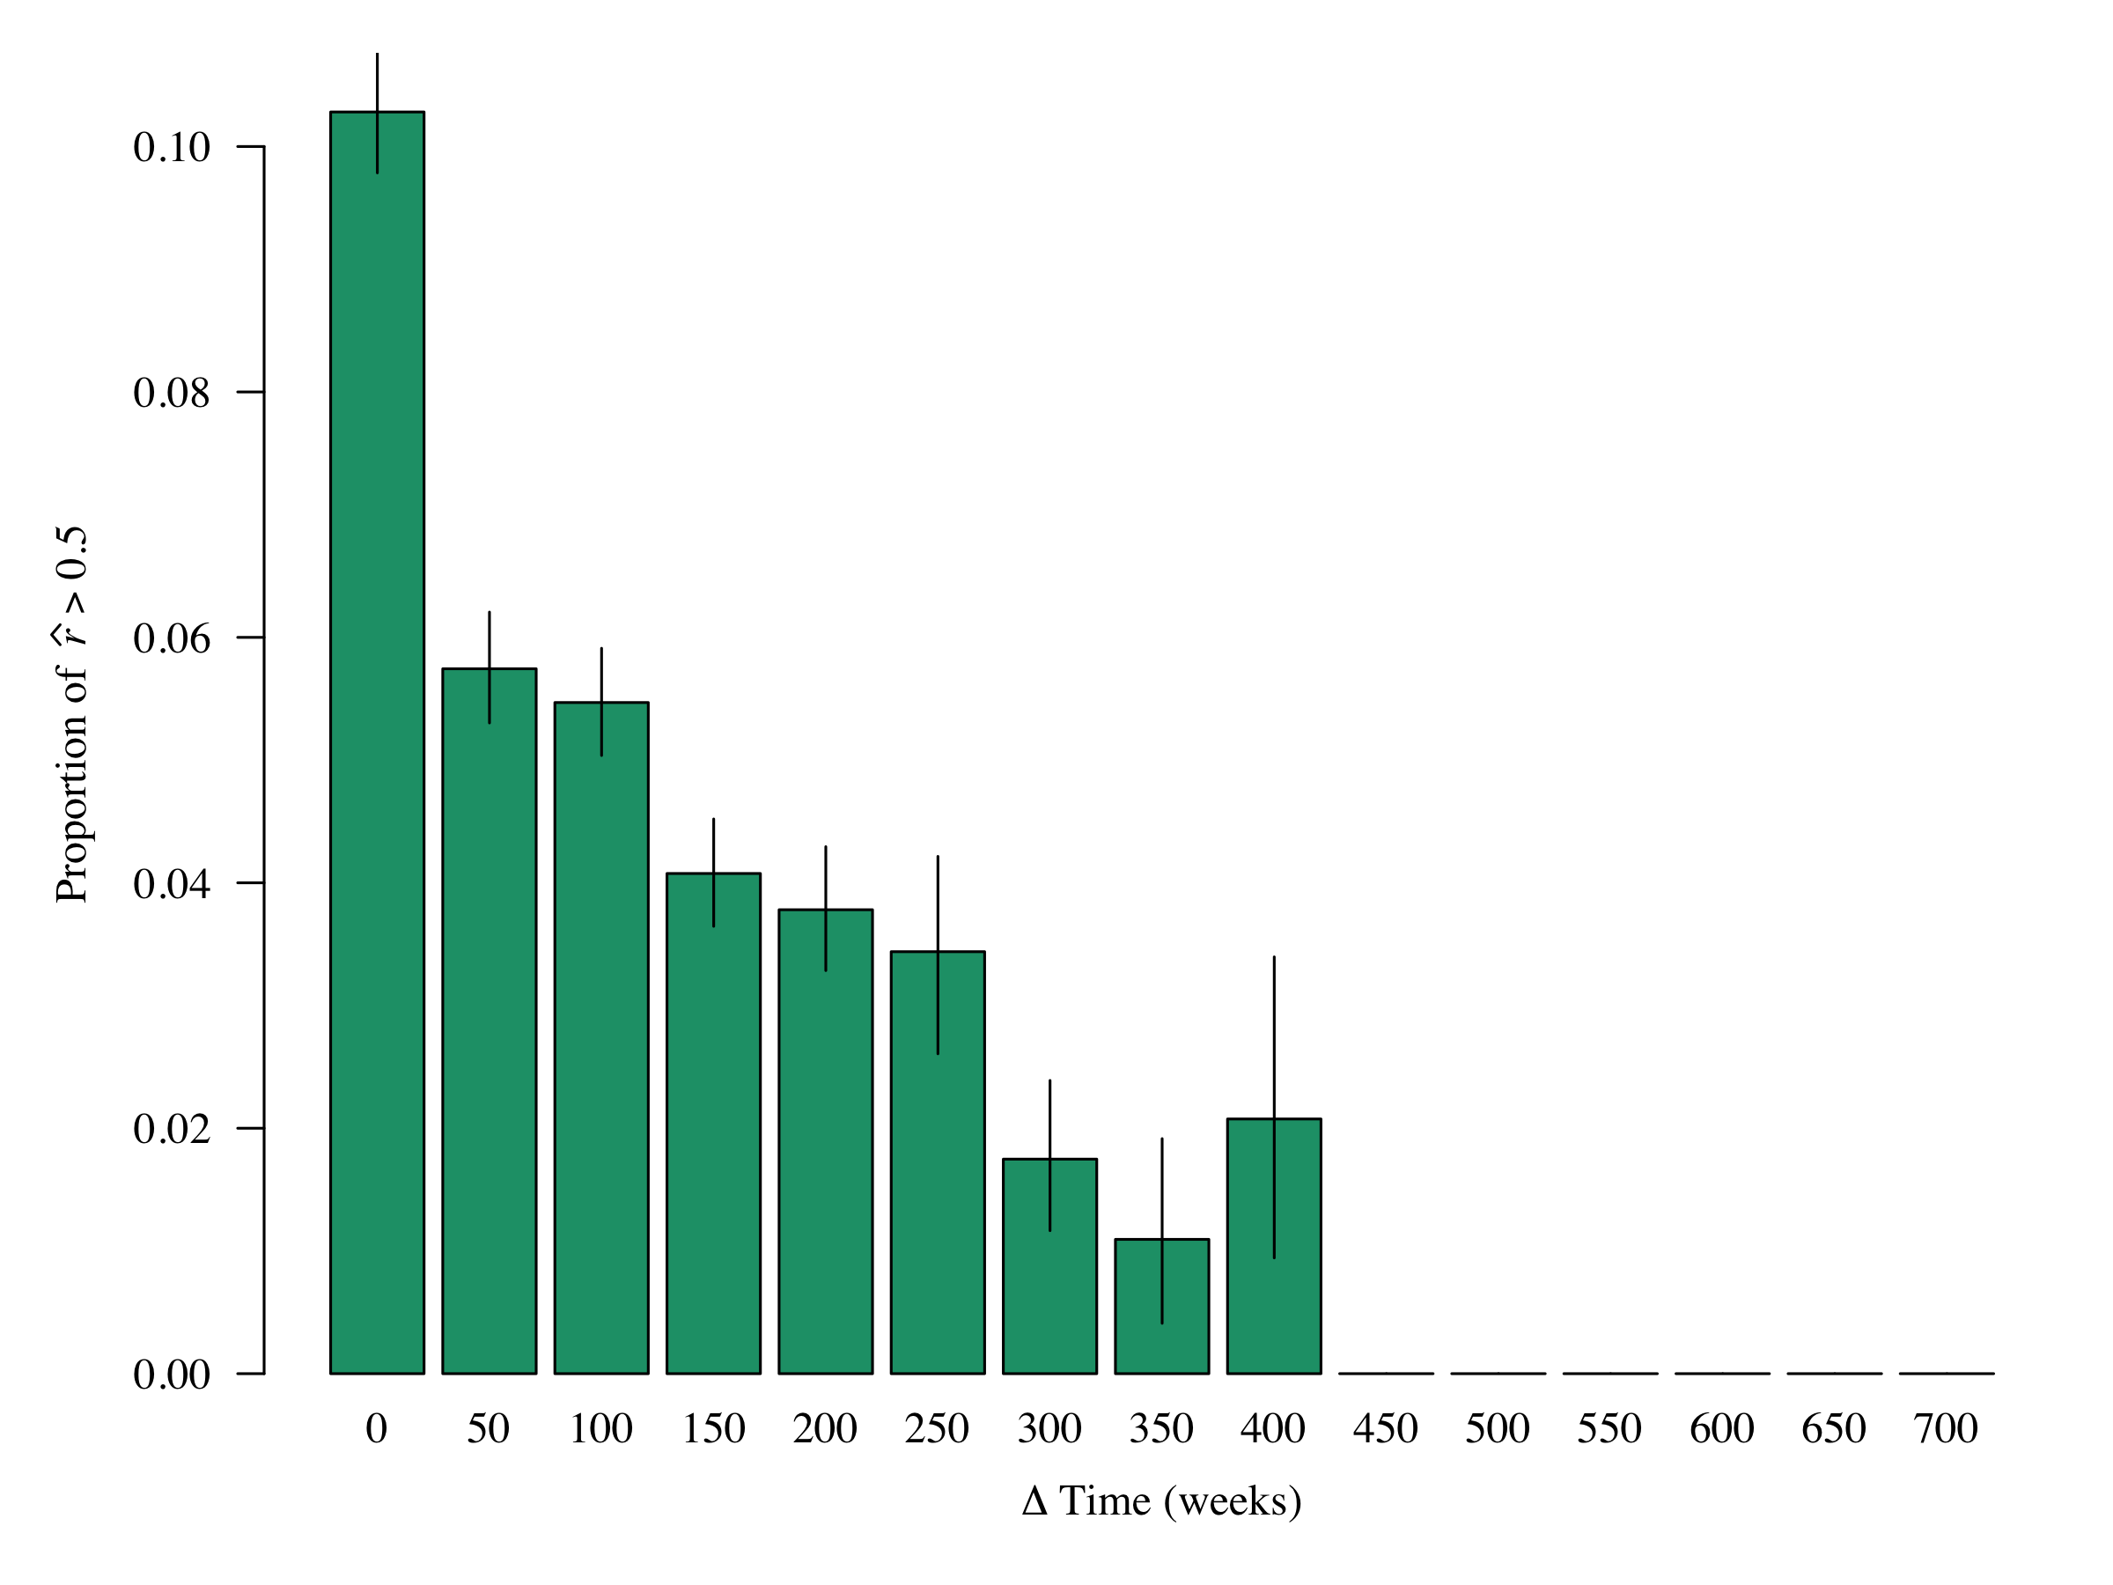
P. falciparum sample pairs more highly related if collected closer together in time
Group estimates by Δ Time
Plot proportion > 0.5 by Δ Time
Unpublished

Slide 7
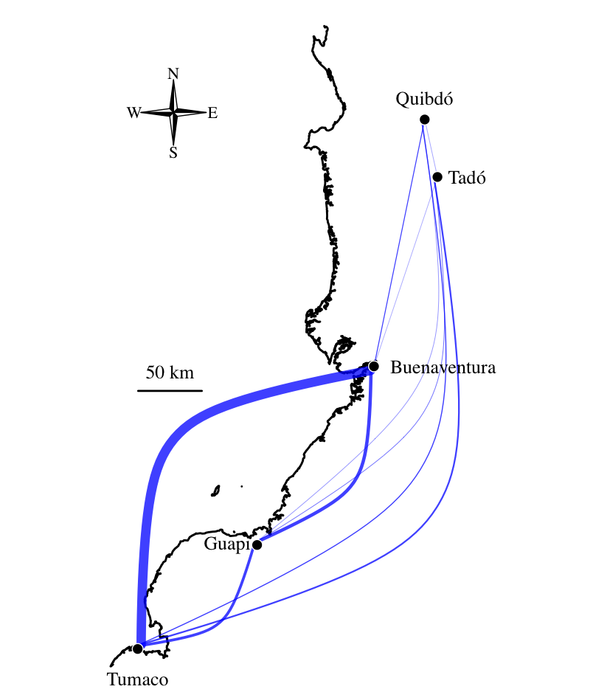
Connectivity across sites
Unpublished
Blue edges proportional to the proportion of highly related parasites between sites
Tumaco and Buenventura are disproportionally connected

Slide 8
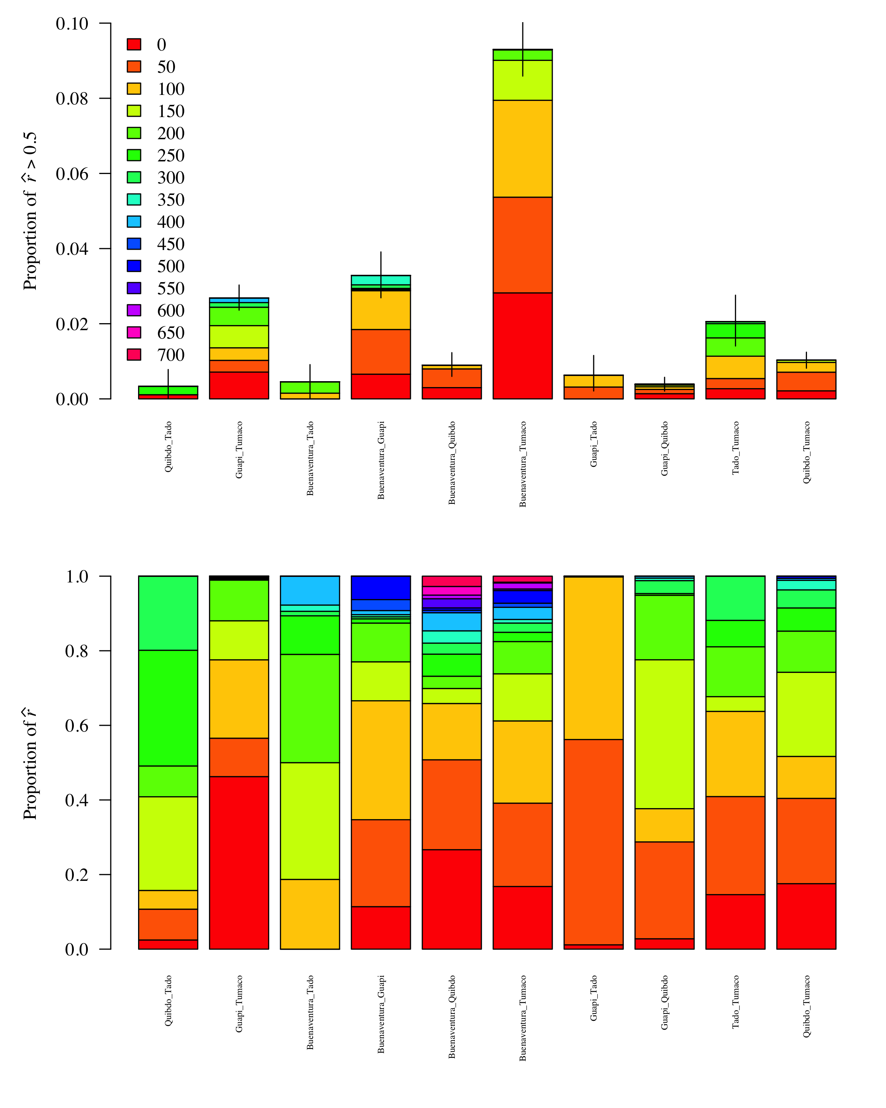
Were samples from Tumaco and Buenventura all collected at the same time? No
Unpublished
Notes:
Change

Slide 9
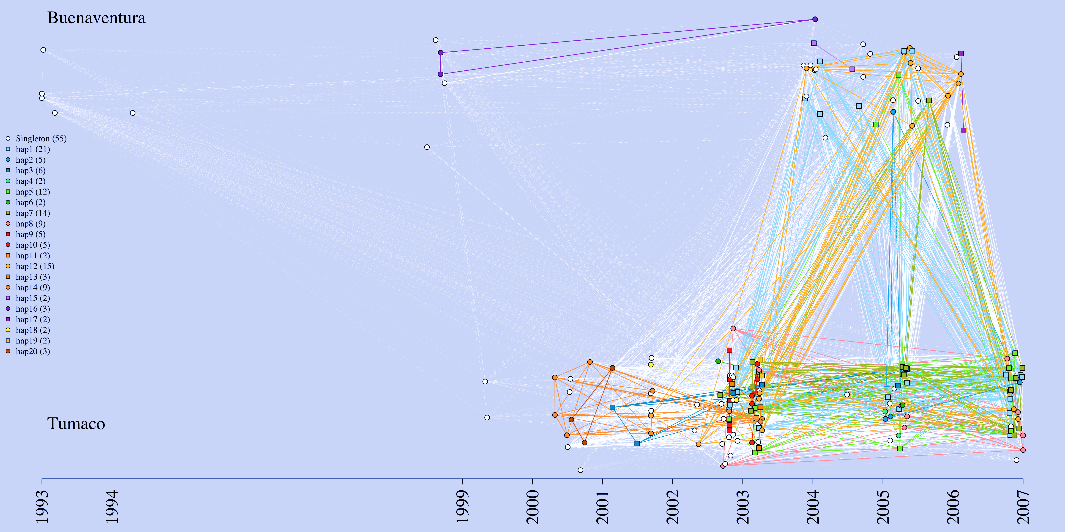
A closer look into the genetic links between ports
Is relatedness between Tumaco and Buenventura
due to one 250-SNP “haplotype”? No
Buenaventura
Tumaco
Notes:
Colored if a repeat “haplotype”. Solid: rhat > 0.5; dashed: rhat ≤ 0.5
How many errors were allowed: 4?
I explored allowing 1:20, 4 to 15 were stable.
How much relatedness does that correspond to?
How different would it be if I only allowed 0 differences?
Haps 1 and are not highly related, but 12 is related to 4:7
The fact that there are multiple repeat haplotypes suggests gene flow was not a one-time event. The fact that each site has some private repeat haplotypes suggests that there is potential for two-way flow.
The number of differently coloured repeat haplotypes might give a false impression of the number of independent pieces of information, however.
Of the haplotypes shared across Buenaventura and Tumaco, haplotypes 5, 7 and 12 are all highly related to one another, so might originate from a single parasite. On the contary, haplotypes 1 and 2 are not highly related to the above cluster nor one-another. Together these results suggest three travel events.

Slide 10
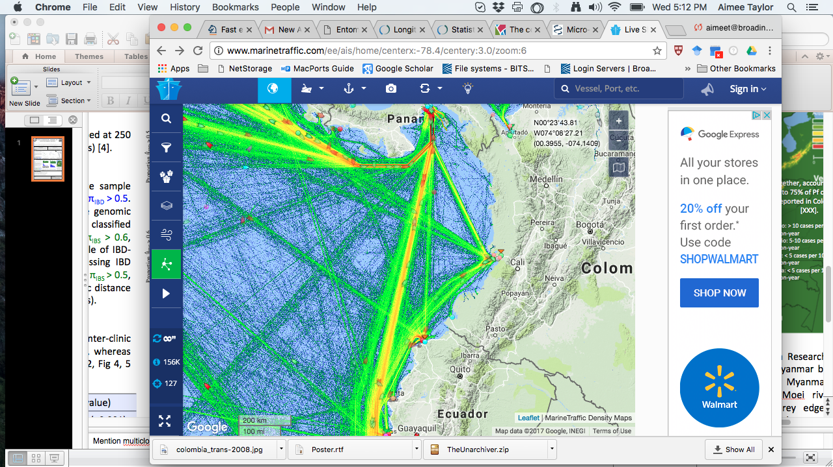
Genetic connectively associated with with marine traffic
www.marinetraffic.com
Ports
Notes:
Vladimir
Guapi to Buenaventura: fast boat, 6-8 ppl, 4 hr; ship cargo, approx. 50 ppl, 12hr;
Tumaco road is a bad road
no public transport between Guapi and Tumaco, only contract fast boat; 1 hr to El Charco (just south of Guapi) and 5hrs from El Charco to Tumaco.
plantain produced in Tumaco is sold in Guapi (and probably Buenventura)
many goods that are received in Buenaventura (the major port of Colombia) are delivered to Tumaco
Diego
By Ship (barco): price: around 80.000 – 100.000 COP (1 USD is 3050 COP)
- Tumaco – Buenaventura: about 17-18 hours.
- Guapi – Buenaventura: about 10 – 12 hours
By Boat (lancha): price around 120.000 COP
- Buenaventura – Guapi: 4h
- Guapi – Tumaco: 3 – 3,5 H
- Buenaventura-Tumaco: No transportation. the sea rout is Buenaventura-Guapi and them Tumaco (and Vice-versa). A express transportation with good accommodation, food, Buenaventura-Guapi-Tumaco may cost up to 4.000.000 COP.
- Road trip Between Guapi and the Panamerican freeway (the blue road in the map): No access at all.
The only inter-municipal road in Guapi es between Guapi (Cauca) and Chanzara (Narino), it is a rudimentary and dangerous way, about 2 hours. People do no use this road.
Hope this helps.. all the info is directly from the sites.

Slide 11
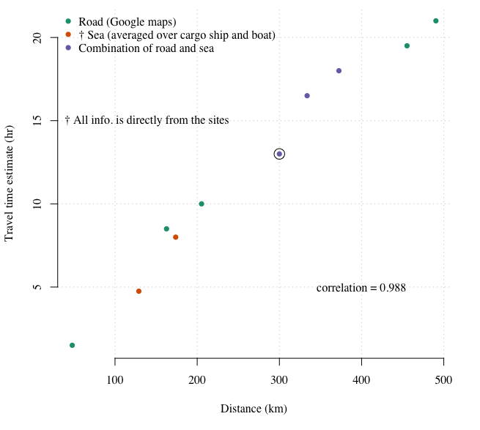
Travel time correlates with geographic distance
Unpublished
Notes:
Acknowledgements

Slide 12
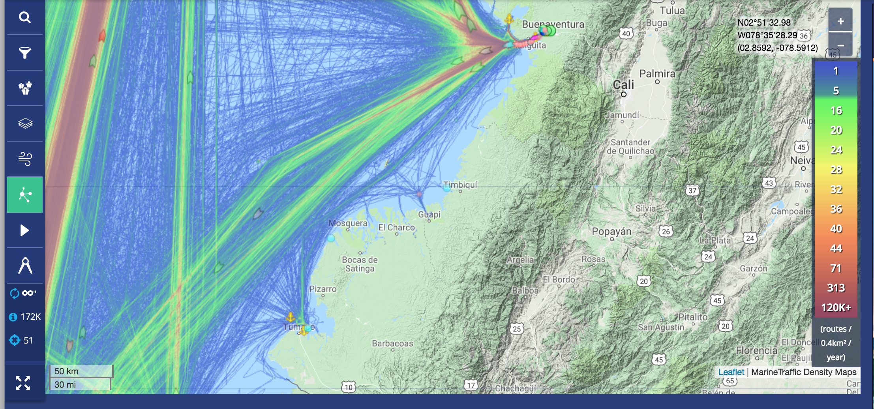
Travel frequency
www.marinetraffic.com
Tumaco & Buenventura: approx. 16 routes per 0.4 km² per year
Guapi & Buenaventura or Tumaco: approx. 1 route per 0.4 km² per year

Slide 13




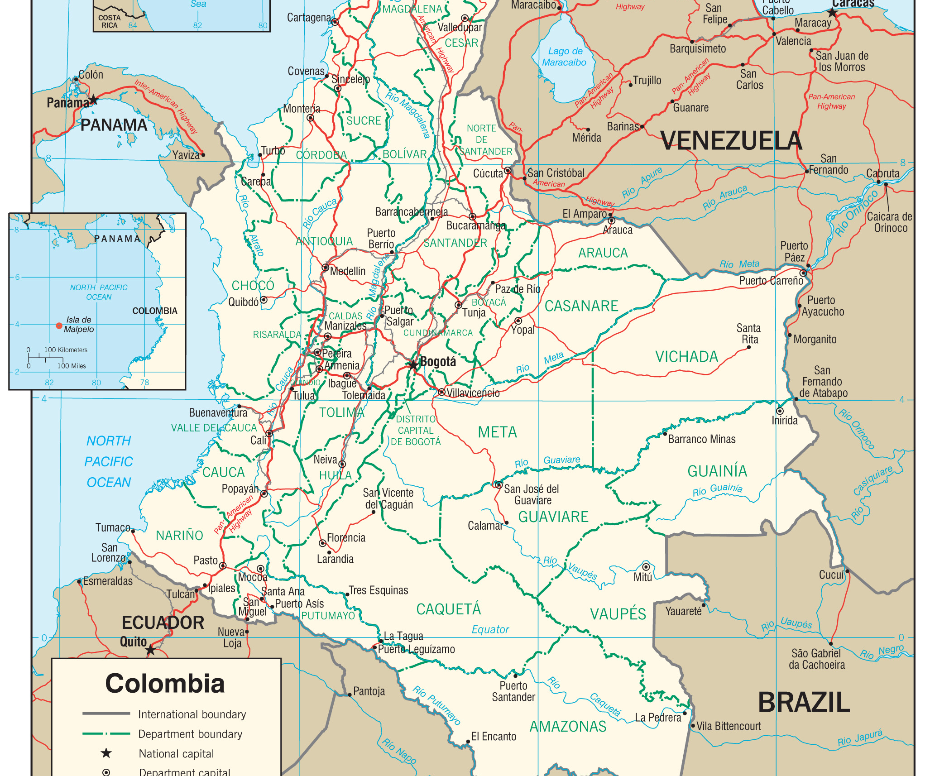
Summary
Evidence of connectivity and spatial-temporal trends in relatedness
Buenaventura and Tumaco are disproportionally connected
Marine travel frequency (versus time) appears to drive connectivity
Can we target marine traffic to interrupt transmission?
Notes:
2. Any interventions should take this into account

Slide 14
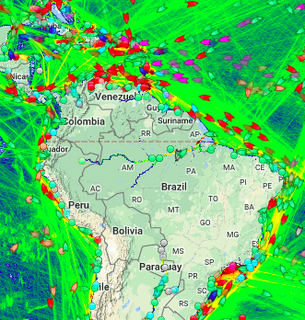
Next steps
Does marine traffic impact malaria transmission more generally?
Prospective data
Probabilistic gravity model, combining complementary data
Works-in-Progress Seminar, Wed, Oct 14th, 1:00-1:50pm, Kresge 502

Slide 15





Thank you
Diego F. Echevarry
Timothy J. Anderson
Daniel E. Neafsey
Caroline O. Buckee
Vladimir Corredor
People in Guapi

Slide 16
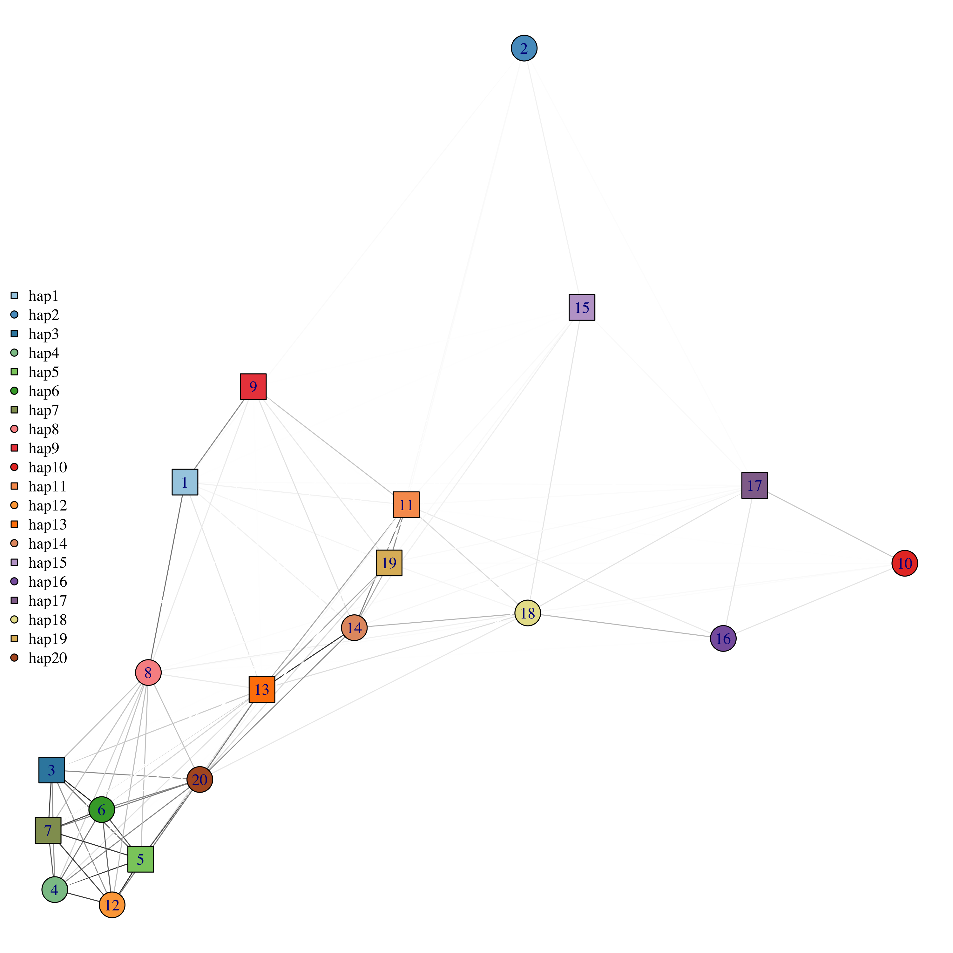
Are the repeat “haplotypes” highly related to one-another?
Some, not all
Edges = r estimates
Unpublished
Notes:
Make into tree / pca / network
Add interpretation
Is the high relatedness due to allowing four differences?
Circle across only

Slide 17
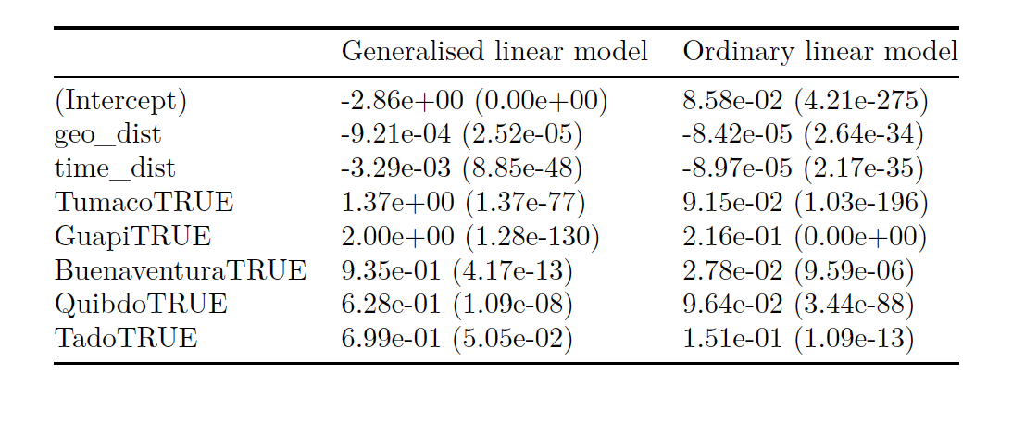
Regression analyses support small but significant negative trends in relatedness with both space and time
Fit to highly related versus not
Fit to r estimates directly
Unpublished

Slide 18
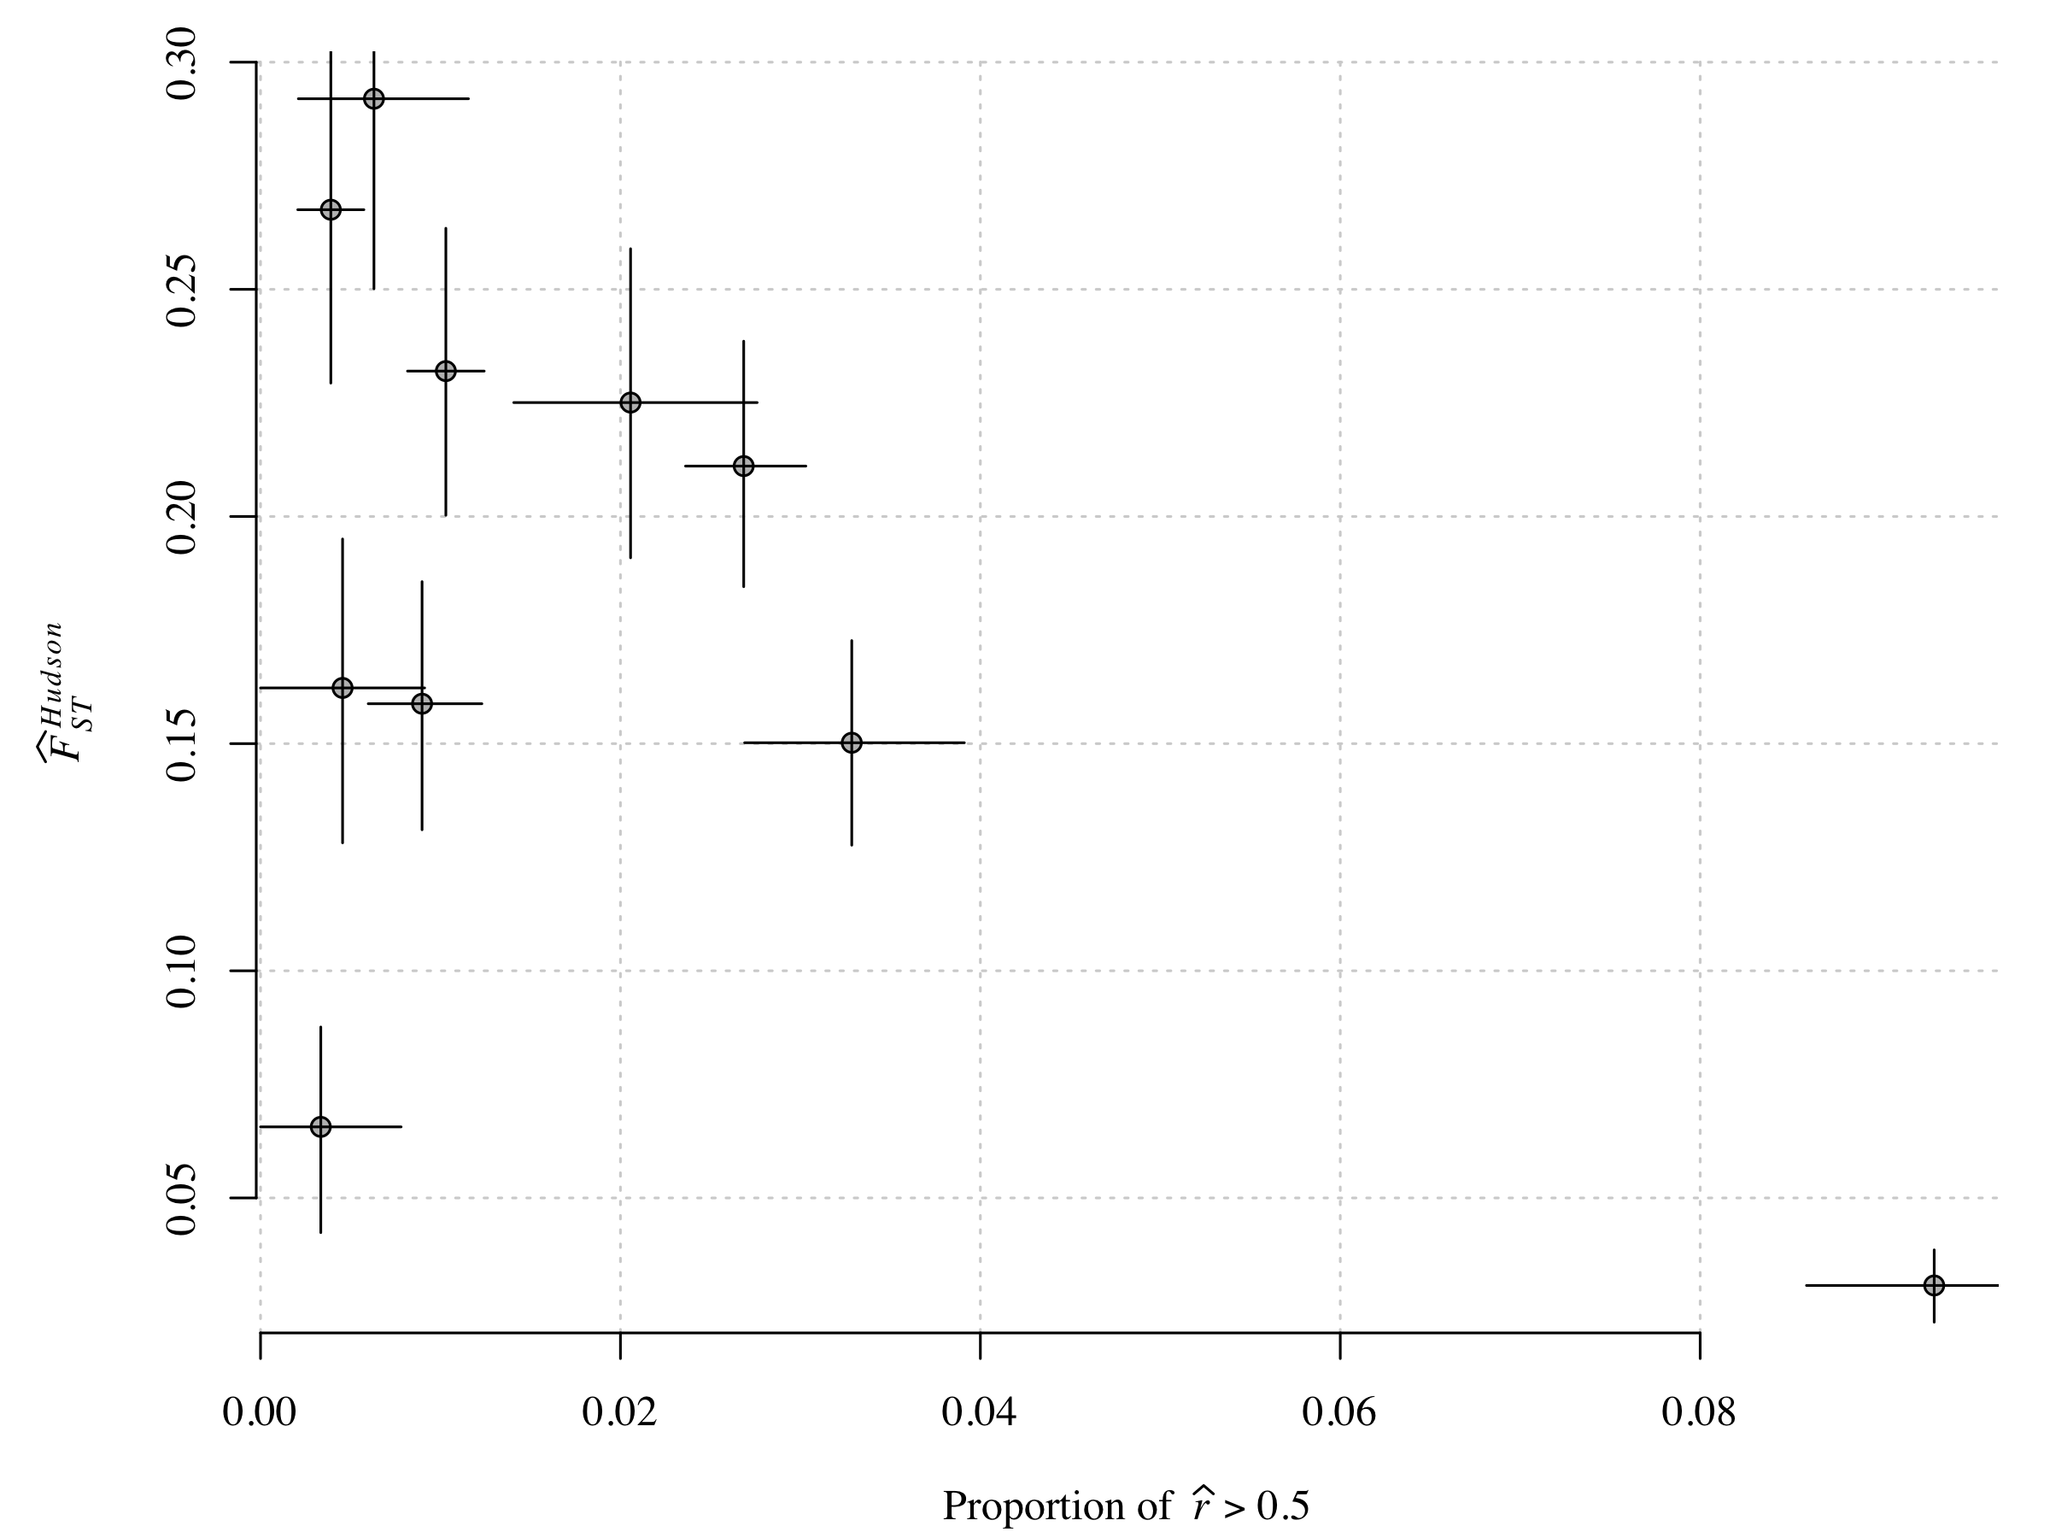
Previously published F_{ST} analyses agree

Slide 19
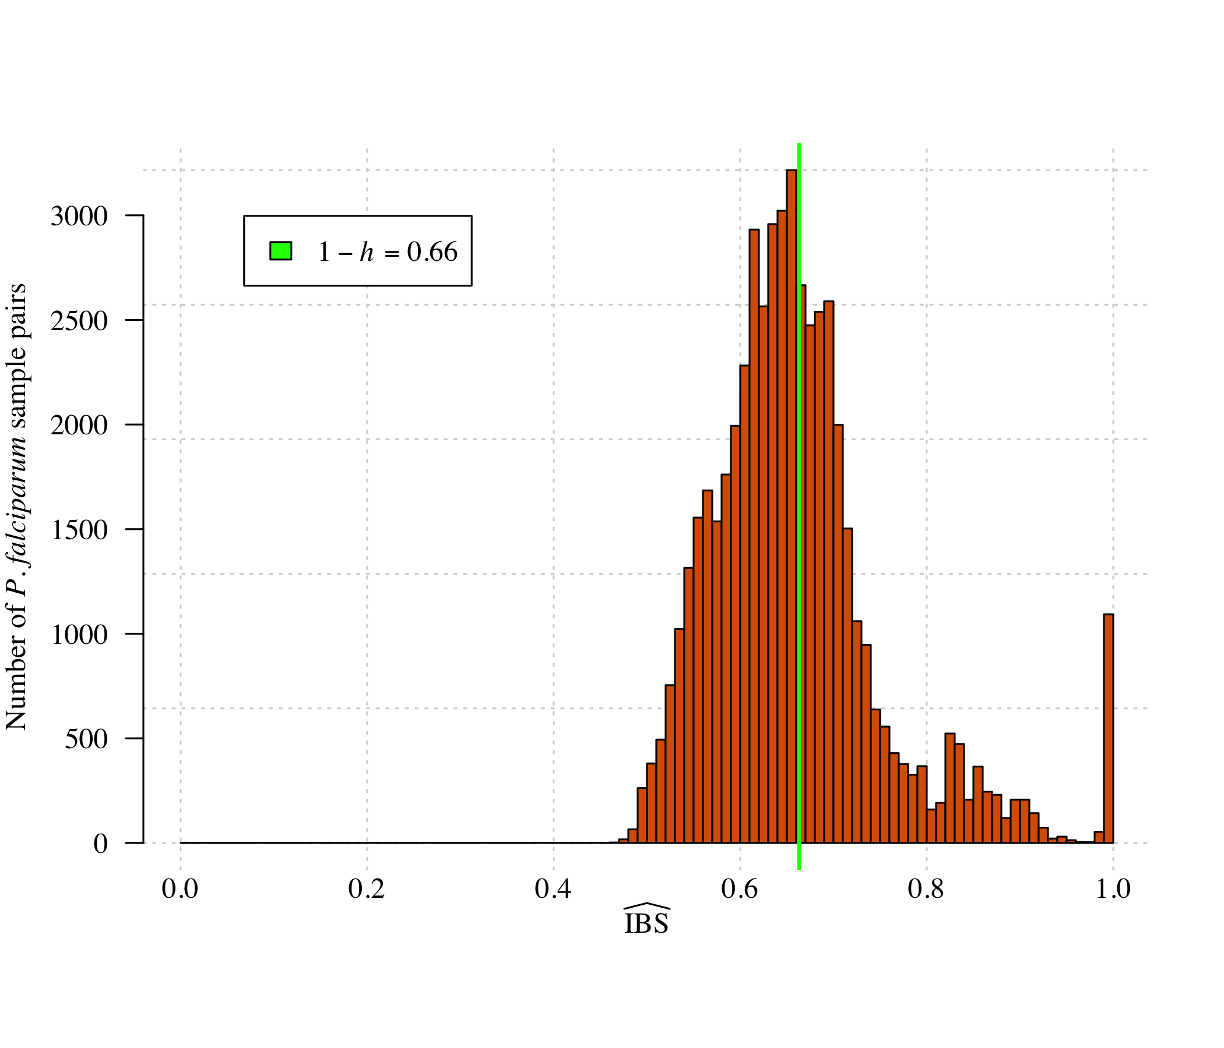
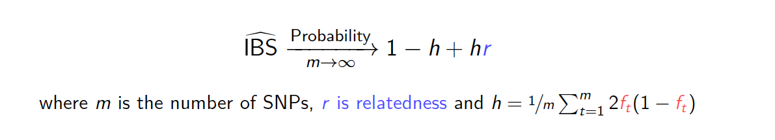
Aside: identity-by-state (IBS) estimates generate similar results despite vastly different distribution
m = number of SNPs
r = relatedness
h = function of allele frequencies
Unpublished
Notes:
Must pick threshold based on knowledge of IBD

